Slide 1
Fire Prevention Officer
Mental Wellness
Notes:
Introduction: R2MR and TWM Instructor
By show of hands how many have had the opportunity to go through one or both of those training programs?
For those who have – some of today will be a refresher and for others this will be new and interesting.
I wanted to specifically connected mental health to your roles as Fire Prevention Officers.
What we’ll talk about today applies at home and at work and you’ll see how it affects you and how you can help family and friends
So let me start with some basics.
Everybody can have a good day, OK day or a bad day.
By that I mean we can wake up feeling on top of the world and ready to take on any challenge OR we wake up feeling a little vulnerable/ slight upset stomach and sometimes we know why and sometimes we don’t. Based on that your mental wellness determines how you think, feel and act.

Slide 2
Examples of FPO work stressors:
Dealing with difficult customers
Presenting unpopular information to the customer
Applying the fire code to an unfamiliar application
Issuing a POA Part 1 ticket to a customer
Swearing information before a JP
Fire Investigation – Origin and Cause
Notes:
So, what kind of stress can impact how you feel as an FPO?

Slide 3
Introduction
What is mental health
How stress affects mental health
How your mental health affects you
How to measure your mental health
Training your brain to handle stress

Slide 4
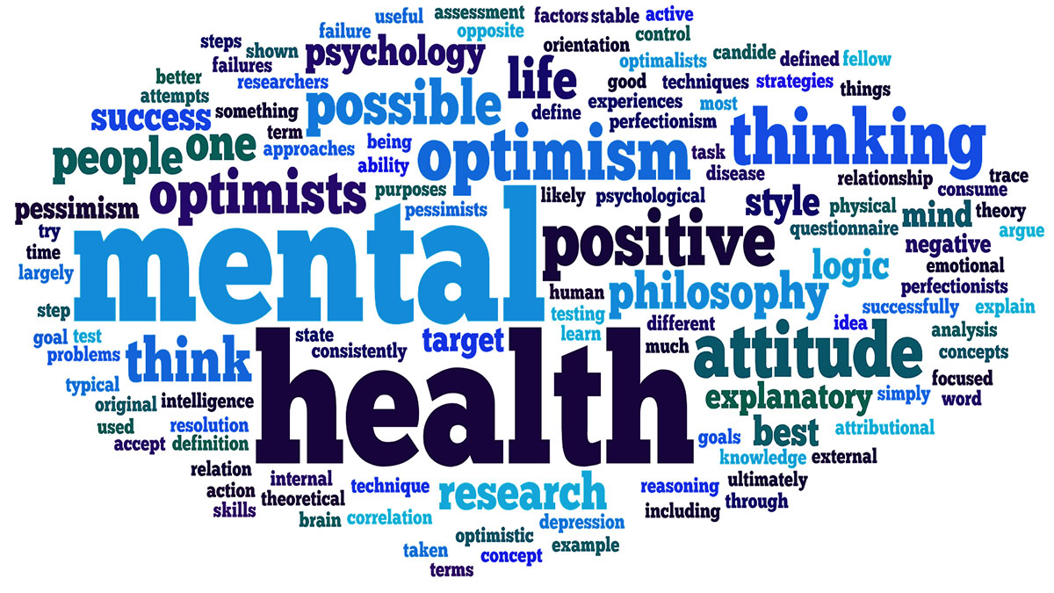
Good Mental Health
Notes:
Good mental health - +ve end of the spectrum or what I like to call your “A” game
Generally satisfied with your personal, family, social and professional life
More active approach to overcoming difficulties
GMH in the workplace is a feeling of balance, satisfaction and effectiveness

Slide 5
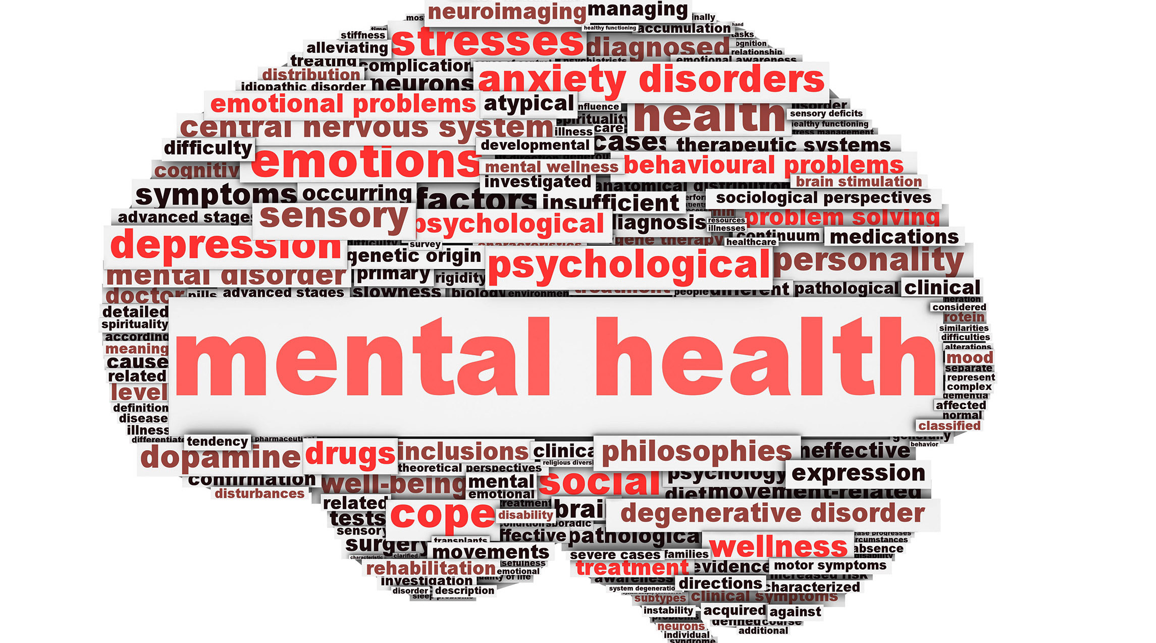
Declining or Poor
Change in ability to cope with stressors
Changes in mood, increased anxiety, declines in physical health
Can still function normally and may appear normal
Notes:
Declining or poor mental health is when your mental health starts to deteriorate but not to the extent or severity of a diagnosable mental illness (sliding off you’re a game)
Is associated with your ability to cope with stressors
You’ll see changes in mood, attitude, increased anxiety and decline in physical health
You can often still function normally and may appear normal to others
Declining mental health can be influenced by increased stress at work and in life, changes in lifestyle, and many other internal and external factors that we’ll talk about

Slide 6
Mental Illness
It’s like any health condition that affects the mind or body
Difficulties in thinking, mood/ behaviour that interferes with daily life
Must be formally diagnosed by psychiatrists or psychologists
Notes:
Talked about GMH, PDMH which if not addressed can lead to a Mental Illness
So what is mental illness?
Everyone can feel worried, anxious or stressed at times.
With a mental illness these thoughts and feelings do not go away and can be severe enough to interfere in your daily life (pre-consumed with whatever is bothering you)
Mental illness is like a health condition that affects the mind or body function (sore back affects the mind)
It can cause changes in thinking, mood and behaviour which ties to feeling distressed and general dysfunction.
Mental illness can make it harder to keep friends, find and hold a job, or enjoy life.
Mental illness can only be formally diagnosed by a mental health professional

Slide 7
Change the way you think
We are all one bad day away from a mental illness.
Notes:
Reference video: Woman working in her office alone and looks up to see a man standing at her desk.
She asks him, “who are you?”
He says, “I am depression and I have come for you.”
She says, “I’m not depressed”.
The man looks in his pocket calendar and says “I’m sorry, it’s next Thursday that you lose your job and your boyfriend leaves you.” (Now there’s an example of sudden stress).
This example shows an important fact of life – when you least expect it, something can happen that will affect your mental health – it can happen anywhere – to anyone – at any time.
So how do YOU know if YOUR mental wellness is being challenged?

Slide 8
Mental Health Continuum Model
Notes:
Visual Measuring Stick using colours to represent different steps or stages of MH – How stress affects you.
Like your physical health, MH can be a sliding scale
The MHCM goes from green “HEALTHY” described as adaptive and coping” with life stressors to
Yellow “Reacting” where you have mild, self-limiting distress with life stressors or
Orange “Injured” which affects how you function with more severe, persistent distress or struggle to function to
Red (Ill) where clinical illnesses and disorders can occur that require more concentrated medical care
<Arrow>
Many people have physical and mental health problems that when identified early can be temporary and reversible
Even if in INJURED or ILL phase, it is possible to be healthy and functioning again
Mental health is a shared responsibility - our jobs as supervisors/ coworkers/ friends and family members is to provide a supportive environment whether at home or at work to keep people in the green and yellow parts of the continuum
If someone starts to become injured or ill, we need to recognize that and help them get back to functioning better as fully as possible
When stress levels increase, a persons ability to function goes down
We’ll explore the MHCM in more detail in a little bit

Slide 9
Exposure to Stress
Stress is wear and tear on the body caused by the need to adapt to changes or demands in the environment.
Acute (short-term reaction to immediate threat)
Chronic (longer-term ongoing situation)
Notes:
We just discussed different levels of MH so lets look at stress and its impact on mental health.
Everyone has stress – not all stress is negative. 2 categories: Acute and Chronic
Acute: Most personal reactions to significant life events are normal. In fact most people deal effectively with the majority of short term stressors in their lives.
But then there’s chronic stress – involves ongoing stress demands with no break (give home/FPO ex.) ME
Research shows that chronic unmanaged stress can be one factor in the development and/or worsening of a wide range of physical and mental health problems. All work and no play makes Donny a dull boy.

Slide 10
Where does stress come from?
External Stressors – major life events, daily hassles
Internal Stressors – interpretation/ perception
Notes:
External – external or outside your body
Major Life Events: extraordinary events that put extra pressure on us (+ve events like: marriage, birth of a child) (-ve events like: death of a loved one/ co-worker/pet, separation or divorce, loss or threatened loss of employment, exposure to a traumatic event
ALFONS story – cab dynamics changed, didn’t feel the same, didn’t feel as confident
Daily Hassles – majority of day to day stressors we face are not extreme life events. It’s the daily hassles – the minor irritations (misplaced car keys, traffic jams, slow drivers, kids messes at home, minor arguments with family/ colleagues. Research has found that it is the daily hassles rather than major life events that STRESS us the most.
Internal – (internal thinking or thought stressors) – these type of stressors are highly individual, in other words its not the demands placed on us that cause the stress, but rather our interpretation that we can’t cope with those demands. This means that this kind of stress is very unique for each person – what may be overwhelming for me may not be for you. It is our own internal beliefs, attitudes, interpretations, perceptions and other factors in combination with external events that tend to create stress. Bottom line: Stress effects mental health!

Slide 11
So, what causes stress?
Any event in life that a person finds threatening, difficult to cope with, or causes excessive pressure.
Organizational
Operational
Personal
Notes:
So lets look at it this way….. Read right off the slide

Slide 12
Organizational Stress
Union/ Management Conflict
Having to perform beyond experience/ abilities
Keeping up with changes, technology
Lack of training, information, support, advice
Time pressures, deadlines
Lack of clear objectives & role expectations
Notes:
Organizational – these are factors that affect an entire unit, regular expected stressors that anyone can anticipate in their day to day life regardless of their occupation. We don’t necessarily experience all of them, or at least not all at once. Perhaps you can see similarities from that list in your workplace.
Example non-fire service: H.J.Heinz downsize initiative
Ketchup, baby food, pasta, soups…57 varieties (manufacturing, warehouse and distribution center) 1 in Canada
1200 employees
75% management reduction
Union Layoffs/ bumping
Lowest cost operator
Efficiencies
Hidden job loss threat
Result: Union/ Management conflict, decreasing staff levels with same/increasing workloads, production #s still required per shift, increased # of departments to manage and learn, trial by failure for new departments of responsibility due to limited info & limited support from remaining disgruntled staff.

Slide 13
Operational Stress
High inspection volume & time pressure
Unfavourable working conditions, shift work
Understaffed
High effort/ low reward
High level of complexity, skills, knowledge, expertise, problem solving
Consequence of error is high
Notes:
Operational Stress – will look different depending on the type of fire service work you do.
Yearly inspections pre-scheduled – violations, uncooperative customers delay inspection completion resulting in carry over into next months schedule
High volume of both scheduled & incoming complaint/request inspections – small office, limited work space, noisy can’t concentrate, workload vs. staffing
Concentrated technical effort & follow ups to close the inspection – typically no thanks/ appreciation for making the customer fire safe
Depending on the occupancy type being inspected, multiple sections of the Fire Code can apply – complex, analysis, code application assessment
What if I missed something significant in my inspection – could people be hurt, could there be property damage, could there be legal action?

Slide 14
Personal Stress
Relationship changes; marriage, separation, new child, sandwich generation
Loss of family or friends
Financial difficulties
Loss of health or ability
Work/life balance issues
Transitions; new job, new town
Notes:
Personal – We all have some levels of personal stress that adds to the daily workplace operational and organizational stresses. Who knew there were so many different sources of stress.

Slide 15
LIFE STRESS
Home and personal stress can have just as much impact as work (operational and organizational) stress
Notes:
Everything combined together can be called Life Stress – While work related stressors are important, not all mental health problems are caused by work.
Sometimes it’s a combination of personal stress, daily hassles and work stress that all come together to give someone a problem.
All types of stress require the same care and consideration.
When feeling over-whelmed – we need to stop and ask ourselves where the stress is coming from – even making a lists helps us to understand.

Slide 16
Mental Health Continuum Model
Notes:
Remember earlier I mentioned the MHCM and called it a Visual Measuring Stick of your metal health/wellness.
Wouldn’t it be neat, if we could get to a place some day, where instead of when I ask how are you today you don’t same I’m good or I’m OK you say I’m GREEN or I’m a little YELLOW today. I might make a point of chatting with you later and asking are you OK and is there anything I can do to help? The point that someone asked, even without knowing any details, can go a long way to making someone feel a little better – its just that easy.
Lets talk about what you would notice if moving along the MHCM?

Slide 17
Changes in Mood
Normal mood fluctuations
Calm
Confident
Irritable
Impatient
Nervous
Sadness
Angry
Anxious
Pervasive Sadness
Easily enraged
Excessive anxiety/panic
Depressed mood, numb
Notes:
More serious…..more distressing as you move to the right
As the intensity and severity of emotions increase and overall functioning decreases.
We go from normal mood fluctuations (meaning not every day is perfect or always happy) to increased irritability and impatience, to more pervasive anger and then enraged.
Calm to impatient to anxious to anxiety or panic or
Normal mood, to sad or overwhelmed, to pervasive sadness, to depressed.
WHEN TO SEEK HELP? MANGO

Slide 18
Changes in Thinking and Attitude
Good sense of humour
Takes things in stride
Ability to concentrate and focus on tasks
Displaced sarcasm
Intrusive thoughts
Sometimes distracted or loses focus on tasks
Negative attitude
Recurrent intrusive thoughts/images
Constantly distracted or cannot focus on tasks
Noncompliant
Suicidal thoughts/intent
Inability to concentrate, loss of memory or cognitive abilities
Notes:
Not only can our mood change, so can our thinking and attitude or basically the way we look at things.
A similar pattern can be found as one’s thoughts and attitudes change from healthy through to ill.
Signs and indicators increase in both frequency and intensity AND overall functioning goes DOWN.
When healthy (green zone) we have the ability to laugh and our sense of humour is intact.
Ever notice as we move into the yellow this turns to displaced sarcasm or humour with an edge.
If moving into orange you have a negative attitude with red getting into non-compliance.
Our ability to think and reason changes moving to the right: concentration and memory problems increase and thinking patterns may start to include suicidal thoughts
WHEN TO SEEK HELP? MANGO

Slide 19
Changes in Behaviour and Performance
Physically and socially active
Performing well
Decreased activity/ socializing
Procrastination
Avoidance
Tardiness
Decreased performance
Withdrawal
Absenteeism
Can’t perform duties/ tasks
Notes:
Talked about Mood Changes, Thinking & Attitude Changes and now Behaviour and Performance
Presenteeism: May be there physically but not mentally
WHEN TO SEEK HELP? MANGO

Slide 20
Physical Changes
Normal sleeping patterns
Good appetite
Feeling energetic
Maintaining a stable weight
Trouble sleeping
Changes in eating patterns
Some lack of energy
Some weight gain or loss
Restless sleep
Loss of appetite
Some tiredness or fatigue
Fluctuations or changes in weight
Cannot fall/ stay asleep
No appetite
Constant and prolonged fatigue or exhaustion
Extreme weight gain or loss
Notes:
Talked about Mood Changes, Thinking & Attitude Changes, Behaviour and Performance Changes and now Physical Changes
What affects us mentally, affects us physically and visa versa.
Our minds and bodies are connected.
If someone is experiencing depression they will have physical symptoms.
One of the physical changes first affected moving along the continuum is sleep.
Ever notice when in the yellow zone, under a bit more stress, you have difficulty sleeping.
It could be falling asleep or waking up with your mind going a mile a minute.
This was a constant challenge for me throughout each career change - LFD wrote down 100 things in the middle of the night.
WHEN TO SEEK HELP? MANGO

Slide 21
Changes in Substance Use
Limited alcohol consumption, no binge drinking
Limited/ no addictive behaviours
No trouble/ impact (social, economic, legal, financial) due to substance use
Regular to frequent alcohol consumption, limited binge drinking
Some regular to addictive behaviours
Limited to some trouble/impact (social, economic, legal, financial) due to substance use
Frequent alcohol consumption, binge drinking
Struggle to control addictive behaviours
Increasing trouble/impact (social, economic, legal, financial) due to substance use
Regular to frequent binge drinking
Addiction
Significant trouble/impact (social, economic, legal, financial) due to substance use
Notes:
Talked about Mood Changes, Thinking & Attitude Changes, Behaviour and Performance, Physical Changes now Substance Use
Other potential dependencies/ addictions under ILL may include: drugs, shopping, sex, food and internet/gaming.
Many people use alcohol or gambling without encountering problems and stay in the green zone.
Some however, with the right group of peers & situations this occasional use can become more regular and can begin to be used as a short term coping strategy which falls into the YELLOW reacting zone.
In those zones there is some increased –ve consequences: hangover, more physical affects, spending more money etc. that don’t interfere significantly with major life areas.
The ORANGE injured zone is characterized by increased use that becomes hard to control and negative consequences in major life areas (relationships, job, education)
Leads to misuse/ abuse substances, increased tolerance to substances, withdrawal symptoms, failed efforts to stop or cut back, inability to follow low risk drinking guidelines
Finally in the RED zone - alcohol, gambling is very frequent with severe consequences in life areas and inability to stay in control. Any attempt to stop using is followed by a relapse, there is a constant obsession with use, and severe to life threatening withdrawal symptoms
WHEN TO SEEK HELP? MANGO

Slide 22
Canadian Centre on Substance Abuse Low Drinking Guidelines
10 drinks a week for women, with no more than 2 drinks per day most days
15 drinks a week for men, with no more than 3 drinks a day most days

Slide 23
Canadian Centre on Substance Abuse Low Drinking Guidelines
Reduce your risk of injury or harm by drinking no more than 3 drinks (ladies) and 4 drinks (men) on any single occasion.
For these guidelines a drink means:
341ml (12oz.) bottle of 5% alcohol beer, cider or cooler
142ml (5oz.) glass of 12% alcohol wine
43ml (1.5oz) serving of 40% distilled
Notes:
Tito, Polar Ice, Smirnoff and Crown are 40% distilled

Slide 24
Quick Recap
Mental Health
Stress
Impact of stress
Mental Health Continuum Model
Notes:
Quick Recap
Talked about what is Mental Health (good, poor/declining and mental illness)
Talked about Stress (short-term/ long-term – external/internal - work stress – home stress – daily hassles)
Talked about how stress affects mental health and your personal well-being
How to measure where your stress level is at using the MHCM
Next we’ll talk about how to train your brain to handle stress.

Slide 25
BIG Four Coping Strategies
Four widely used techniques to cope with stress:
SMART goal setting
Mental Rehearsal/ Visualization
Self-talk
Tactical Breathing
Notes:
Here we’ll cover some tools you can use to overcome stress (at work or home) and build your confidence so you can manage the situation.
These techniques are widely used to cope with both everyday and short term stressors
The US Navy Seals – recruit failure rates 36/140 – introduced Big Four at the recruit level to help them cope with the recruit training challenges and made a big difference in the pass rates.

Slide 26
1 - SMART Goal Setting
Specific – Who, What, Where
Measurable - How much, How many, How long
Attainable – Can I do it
Relevant – Why
Time-bound – When
Notes:
Goal-setting comes naturally to some and is a struggle for others. Using the SMART points makes it easy.
Specific: Goals must include a specific behaviour or action by you.
Measurable: You have to be able to see progress. If you can’t measure it, you don’t know when you’ve achieved it.
Attainable: Goals must be challenging, realistic and possible to achieve.
Relevant: Goals need to be relevant and motivate you; You must either want it or need it.
Time-bound: You most know when you will achieve your goal – set the finish line
Goals provide direction, feedback and motivation. Goals are best attained when tackled in small chunks. Think of goal like eating an apple: you must break it into small bites to be successful.
Goal setting builds confidence, helps you focus, gets you thru a busy inspection day; one inspection site at a time. We’ll apply this to your FPO role in a few more slides.
Personal Story: Frank Brule – 100 mile marathon and raised $17500 for children’s cancer. How do you eat an elephant – one bite at a time.

Slide 27
2 - Visualization
Mentally prepare yourself for “what ifs.”
Predict possible problems and work out a solution in advance
Used to rehearse situations and strategies
Train the brain
Notes:
Used to mentally rehearse situations and strategies to anticipate events and prepare for the challenges ahead.
Be calm and relaxed
Trains your brain for what might happen – reducing stress levels
Use all your senses
See positive mental images
Keep the visualization simple
Means you are prepared, means you are confident in the outcome, means you know how to handle this, means you got this girlfriend.
90% of Olympic athletes use this (bob sled races, snow birds, hockey players)

Slide 28
3 – Self-talk
Become aware of your self-talk
Replace negative with positive
Just because we say something doesn’t mean it’s true
Use key words:
Focus I’ve got this
I can do this I’m trained for this
Notes:
We continuously talk to ourselves in our minds – known as self-talk.
If we tell ourselves we can’t do something or we won’t succeed – that is often the outcome
STOP the negative messaging – replace it with positive
Our thoughts about a situation lead to our emotions and behaviour – it is not the situation itself
If our self-talk is positive, our thoughts will tend to follow – along with our emotions, actions and success rate
Did you know we talk between 300 to 1000 words a minute to ourselves.
Think about this: Is your self talk more –ve than +ve? Do you ever say something –ve to yourself that you would never say to a friend?
Remember how we feel comes from how we think.
Take control of your thoughts!
This is one of the hardest skills of the Big 4 to learn.
If nervous or feeling unsure – look in the mirror – put hands on hips and say those words to yourself – it works – you’ll feel a new sense of confidence

Slide 29
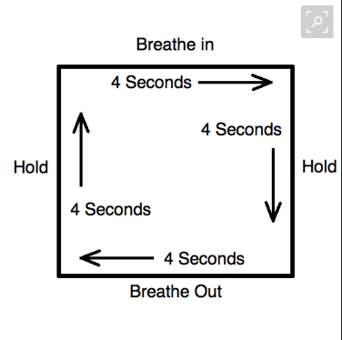
Tactical Breathing
Notes:
So far talked about: Goal Setting, Visualization, Self-talk and lastly Tactical Breathing.
Tactical breathing is particularly important when we are stressed because our natural physical reaction is to have rapid, shallow breathes
Shallow or irregular breathing causes the psychological symptoms of anxiety
Tac breathing reduces anxiety – benefits are almost immediate
TB: delivers oxygen to the brain, relaxes the central nervous system, calms the body and mind, improves performance
With practice you can successfully calm yourself down – the benefits are immediate.
Remember this: Its impossible to have 2 emotions at once – you can’t be agitated and relaxed at the same time.
Group exercise!!!! (pg. 141)
Swat teams use
I use it – council meetings, MRI, public speaking, writing an exam, responding to an emergency (captain orders tac breathing - calm in the cab before arrival), interviews, discussions with your significant other, testifying in court, FF mayday situation

Slide 30
Using the BIG 4
Goal Setting
Visualization (mental rehearsal)
Self-Talk
Tactical Breathing
Notes:
Perhaps you already use one or more of these tools and didn’t realize it?
I use them for council meetings – explain
Lets apply to a FPO scenario:

Slide 31
Dealing with difficult customers
Goal Setting
Visualization (mental rehearsal)
Self-Talk
Tactical Breathing
Notes:
Why is this a difficult customer?
Am I picking a time of day to visit that is their busy time (eg. Restaurant (breakfast, lunch, supper times) Schedule a less demanding time)
Consider a different approach (they likely know you have the authority – so don’t go in heavy handed – try a soft approach – your job is to educate, inform, enforce
Break the visit up into pieces (first I’ll try & set the tone, light casual discussion, leads in to your document review, physical inspection/ note taking etc.
Visualize those pieces as to how you see them going, where you might encounter difficulty and how you can best manage your approach for the smoothest outcome
Self-Talk: I can do this, I’m trained for this, I’m not going to get my back up, I’m a professional
TB: If you find yourself becoming nervous, anxious, mad then start your TB (remember can’t be 2 emotions at same time)

Slide 32
Review
What is mental health
How stress affects mental health
How your mental health affects you
How to measure your mental health
Training your brain to handle stress

Slide 33
THANK-YOU
Notes:
Just before I finish I want to thank YOU!
As fire prevention officers you got a lot going on – Just think about it for a second…..
There’s not a lot of love for you coming from your fire suppression brothers and sisters. You know why….I’ll tell you why –
You are an assistant to the fire marshall – guess what…they’re not
You have more rights of entry – guess what – they don’t
You help prevent and reduce the chance of fire occurring every day – they don’t
You educate every customer you come in contact with – they don’t
You save more lives and property every day through fire code enforcement then they’ll save over an entire career
And lastly, whether they realize it or not, through your proactive inspections, you save and protect their ass from fire
Do I hear a hell yah….

